Slide 1
Chapter 3: Loading and Handling Data in R
Store data of varied data types into vectors, matrixes, and lists
Load data from .csv, spreadsheets, web, Jason documents, and XML
Deal with missing or invalid values
Run R functions on the data (sum(), min(), max(), rep(), grep(), substr(), strsplit(), etc.)
Use R with databases such as MySQL, PostgreSQL, SQLlite, and JasperDB
Create visualisations to help with deeper understanding of data

Slide 2
Introduction
Enterprise applications today generate a huge amount of data.
This data is analysed to draw useful insights that can help decision makers make better and faster decisions.
This chapter introduces the different data types such as numbers, text, logical values, dates, etc., supported in R.
It also describes various R objects such as vector, matrix, list, dataset, etc.,
how to manipulate data using R functions such as sum(), min(), max(), rep() and string functions such as substr(), grep(), strsplit(), etc.
It explores import of data into R from .csv (comma separated values), spreadsheets, XML documents, JASON (Java Script Object Notation) documents, web data, etc., and interfacing R with databases such as MySQL, PostGreSQL, SQLlite, etc.

Slide 3
Challenges of analytical Data Processing
Analytical data processing is a part of business intelligence that includes relational database, data warehousing, data mining and report mining.
It is a computer processing technique that handles different types of business processing practices like sales, budgeting, financial reporting, management reporting, etc.
Data Formats
Data Quality
Project Scope
Output Result via Stakeholder Expectation Management

Slide 4
Data Formats
Data is the main element of business analytics.
Business analytics uses sets of data to store a large amount of data.
Selecting a data format is the first challenge in analytical data processing for researchers or developers.
R is a well-documented programming language that stores data in the form of an object.
It has a very simple syntax that helps in processing any type of data.
R provides many packages and features such as open database connectivity (ODBC), which process different types of data formats.

Slide 5
Data Quality
Maintaining data quality is another challenge in analytical data processing.
Business analysts are required to deliver perfect information, inferences, outliers and output without any missing or invalid value.
A data with inferior input or output is bound to give incorrect quality results.
With the help of R, business analysts can maintain data quality.
Different tools of R help business analysts in removing invalid data, replacing missing values and removing outliers in data.

Slide 6
Project Scope
Projects based on analytical data processing are costly and time consuming.
Hence, before starting a new project, business analysts should analyse the scope of the project.
They should identify the amount of data required from external sources, time of delivery and other parameters related to the project.

Slide 7
Output Result via Stakeholder Expectation Management
In analytical data processing, analysts design projects that generate output with different types of values like p-value, the degree of freedom, etc.
However, users or stakeholders prefer to see the output.
The stakeholders do not want to see the constraints used in data processing, assumptions, hypothesis, p-values, chi-square value or any other value.
Hence, an analytical project should try to fulfil all the expectations of the stakeholders.

Slide 8
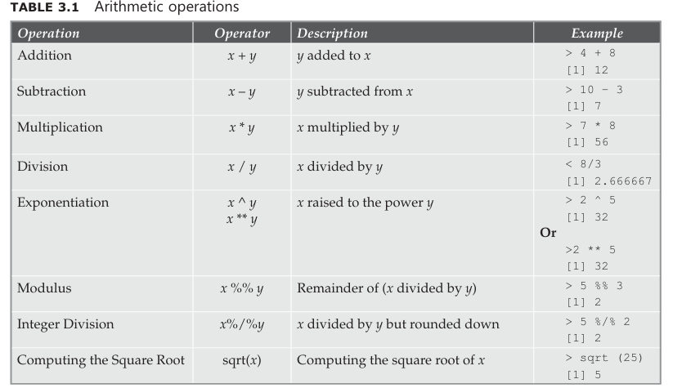
Expression , Variables and functions
Few arithmetic operations such as addition, subtraction, multiplication, division, exponentiation, finding the remainder (modulus), integer division and computing the square root

Slide 9
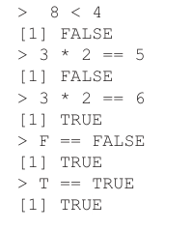
Logical Values
Logical values are TRUE and FALSE or T and F. Note that these are case sensitive. The equality operator is ==.

Slide 10
Guided Activity
Step 1: Create a vector, x consisting of 10 elements with values ranging from 1 to 10.
Step 2: Display the contents of the vector, x.
Step 3: Print the values of those elements whose values are either greater than 7 or less than 5.
Step 4: Print the values of those elements whose values are greater than 7 and less than 10.

Slide 11
Guided Activity-solution
Step 1: Create a vector, x consisting of 10 elements with values ranging from 1 to 10. Section 3.5 of this chapter deals with creation, accessing vector elements and vector arithmetic, etc.
> x <- c(1:10)
Step 2: Display the contents of the vector, x.
> x [1] 1 2 3 4 5 6 7 8 9 10
Step 3: Print the values of those elements whose values are either greater than 7 or less than 5.
>x[(x>7) | (x<5)] [1] 1 2 3 4 8 9 10
Step 4: Print the values of those elements whose values are greater than 7 and less than 10.
> x[(x>7) & (x<10)] [1] 8 9

Slide 12
Dates
The default format of date is YYYY-MM-DD.
Print system’s date.
Print system’s time.
Print the time zone.
Print today’s date.
Store date as a text data type.
Convert the date stored as text data type into a date data type.
Find the difference between the following two dates.red as text data type into a date data type.
Find the difference between the following two dates.

Slide 13
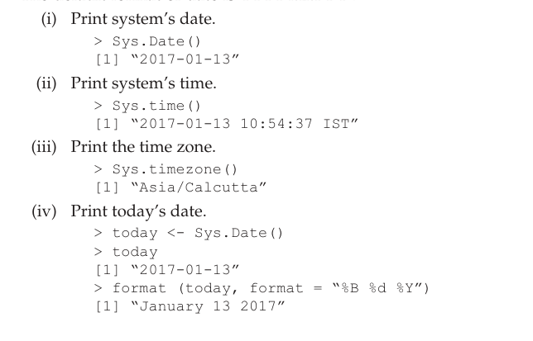
Solution-Slide #12

Slide 14
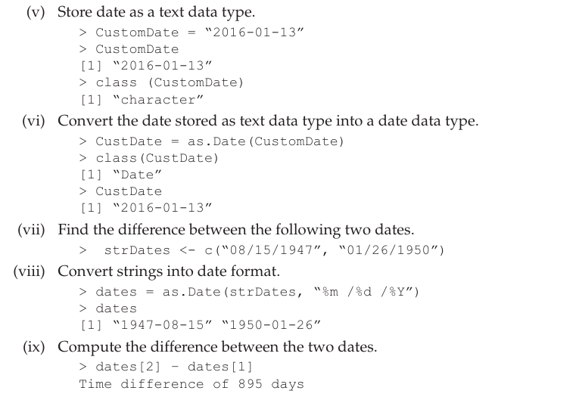
Solution-Slide #12

Slide 15
Variables
(i) Assign a value of 50 to the variable called ‘Var’.
(ii) Print the value in the variable, ‘Var’.
(iii) Perform arithmetic operations on the variable, ‘Var’.
(iv) Reassign a string value to the variable, ‘Var’. Print the value in the variable, ‘Var’.
v)Reassign a logical value to the variable, ‘Var’.

Slide 16
Solution-slide#15
(i) Assign a value of 50 to the variable called ‘Var’.
> Var <-50
Or
> Var=5
(ii) Print the value in the variable, ‘Var’.
> Var
[1] 50
(iii) Perform arithmetic operations on the variable, ‘Var’.
> Var + 10
[1] 60
> Var / 2
[1] 25
(iv) Reassign a string value to the variable, ‘Var’. Print the value in the variable, ‘Var’.
> Var <- “R is a Statistical Programming Language”
> Var
[1] “R is a Statistical Programming Language”
(v) Reassign a logical value to the variable, ‘Var’.
> Var <- TRUE
> Var
[1] TRUE

Slide 17
Functions
sum() function
sum() function returns the sum of all the values in its arguments.
Syntax
sum(..., na.rm = FALSE)
where ... implies numeric or complex or logical vectors.
na.rm accepts a logical value.
Should missing values (including NaN (Not a Number)) be removed?

Slide 18
sum() function-Examples
(i) Sum the values ‘1’, ‘2’ and ‘3’ provided as arguments to sum()
(ii) What will be the output if NA is used for one of the arguments to sum()?
(iii) What will be the output if NaN is used for one of the arguments to sum()?
(iv) What will be the output if NA and NaN are used as arguments to sum()?
(v) What will be the output if option, na.rm is set to TRUE?

Slide 19
Solution-slide#18
Examples
(i) Sum the values ‘1’, ‘2’ and ‘3’ provided as arguments to sum()
> sum(1, 2, 3)
[1] 6
(ii) What will be the output if NA is used for one of the arguments to sum()?
> sum(1, 5, NA, na.rm=FALSE)
[1] NA
If na.rm is FALSE, an NA or NaN value in any of the argument will cause NA or
NaN to be returned.
(iii) What will be the output if NaN is used for one of the arguments to sum()?
> sum(1, 5, NaN, na.rm= FALSE)
[1] NaN
(iv) What will be the output if NA and NaN are used as arguments to sum()?
> sum(1, 5, NA, NaN, na.rm=FALSE)
[1] NA
(v) What will be the output if option, na.rm is set to TRUE?
If na.rm is TRUE, an NA or NaN value in any of the argument will be ignored.
> sum(1, 5, NA, na.rm=TRUE)
[1] 6
> sum(1, 5, NA, NaN, na.rm=TRUE)
[1] 6

Slide 20
min() function
min() function returns the minimum of all the values present in their arguments.
Syntax
min(..., na.rm=FALSE)
where ... implies numeric or character arguments and na.rm accepts a logical value.
Should missing values (including NaN) be removed?

Slide 21
min() function
What will be the output for the following commands?
> min(1, 2, 3)
> min(1, 2, 3, NA, na.rm=FALSE)
> min(1, 2, 3, NaN, na.rm=FALSE)
> min(1, 2, 3, NA, NaN, na.rm=FALSE)
> min(1, 2, 3, NA, NaN, na.rm=TRUE)

Slide 22
Solution-slide#21
Example
> min(1, 2, 3)
[1] 1
If na.rm is FALSE, an NA or NaN value in any of the argument will cause NA or NaN to be returned.
> min(1, 2, 3, NA, na.rm=FALSE)
[1] NA
> min(1, 2, 3, NaN, na.rm=FALSE)
[1] NaN
> min(1, 2, 3, NA, NaN, na.rm=FALSE)
[1] NA
If na.rm is TRUE, an NA or NaN value in any of the argument will be ignored.
> min(1, 2, 3, NA, NaN, na.rm=TRUE)
[1] 1

Slide 23
max() function
max() function returns the maximum of all the values present in their arguments.
Syntax
max(..., na.rm=FALSE)
where ... implies numeric or character arguments
na.rm accepts a logical value.
Should missing values (including NaN) be removed?

Slide 24
Example
> max(44, 78, 66)
[1] 78
If na.rm is FALSE, an NA or NaN value in any of the argument will cause NA or NaN to be returned.
> max(44, 78, 66, NA, na.rm=FALSE)
[1] NA
> max(44, 78, 66, NaN, na.rm=FALSE)
[1] NaN
> max(44, 78, 66, NA, NaN, na.rm=FALSE)
[1] NA
If na.rm is TRUE, an NA or NaN value in any of the argument will be ignored.
> max(44, 78, 66, NA, NaN, na.rm=TRUE)
[1] 78

Slide 25
seq() function
seq() function generates a regular sequence.
Syntax
seq(start from, end at, interval, length.out)
where,
Start from: It is the start value of the sequence.
End at: It is the maximal or end value of the sequence.
Interval: It is the increment of the sequence.
length.out: It is the desired length of the sequence.

Slide 26
Example
> seq(1, 10, 2)
[1] 1 3 5 7 9
> seq(1, 10, length.out=10)
[1] 1 2 3 4 5 6 7 8 9 10
> seq(18)
[1] 1 2 3 4 5 6 7 8 9 10 11 12 13 14 15 16 17 18
Or
> seq_len(18)
[1] 1 2 3 4 5 6 7 8 9 10 11 12 13 14 15 16 17 18
> seq(1, 6, by=3)
[1] 1 4

Slide 27
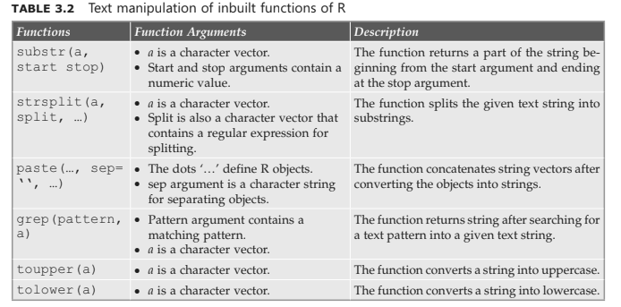
Manipulating Text in Data

Slide 28
Manipulating Text in Data
rep() function
rep() function repeats a given argument for a specified number of times. In the example
below, the string, ‘statistics’ is repeated three times.
Example
> rep(“statistics”, 3)
[1] “statistics” “statistics” “statistics”
grep() function
In the example below, the function grep() finds the index position at which the string,
‘statistical’ is present.
Example
> grep(“statistical”,c(“R”,“is”,“a”,“statistical”,“language”),
fixed=TRUE)
[1] 4

Slide 29
toupper() function
toupper() function converts a given character vector into upper case.
Syntax
toupper(x)
x ->is a character vector
Example
> toupper(“statistics”)
[1] “STATISTICS”
Or
> casefold (“r programming language”, upper=TRUE)
[1] “R PROGRAMMING LANGUAGE”

Slide 30
Manipulating Text in Data
tolower() function
tolower() function converts the given character vector into lower case.
Syntax
tolower(x)
x -> is a character vector
Example
> tolower(“STATISTICS”)
[1] “statistics”
Or
> casefold(“R PROGRAMMING LANGUAGE”, upper=FALSE)
[1] “r programming language”

Slide 31
Manipulating Text in Data
substr() function
substr() function extracts or replaces substrings in a character vector.
Syntax
substr(x, start, stop)
x ->character vector
Start -> start position of extraction or replacement
stop ->stop or end position of extraction or replacement
Example
Extract the string ‘tic’ from ‘statistics’. Begin the extraction at position 7 and continue the
extraction till position 9.
> substr(“statistics”, 7, 9)
[1] “tic”

Slide 32
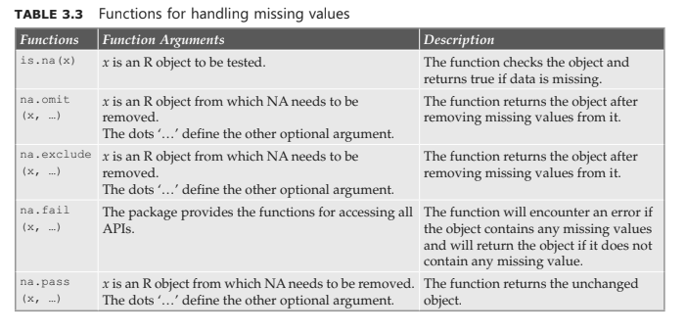
Missing Values Treatment in R
During analytical data processing, users come across problems caused by missing and
infinite values. To get an accurate output, users should remove or clean the missing values.
In R, NA (Not Available) represents missing values and Inf (Infinite) represents infinite
values. R provides different functions that identify the missing values during processing

Slide 33
Using the ‘as’ operator to Change the structure of Data
Sometimes analytical data processing requires data conversion from one data format
into another.
Generally, analytical data processing stores data in a table format, wherein it requires only some part of the table or another structure to store the table’s data.
In this c
The operator ‘as’ provides the facility to convert the structure of one dataset into another
structure in R.
The syntax of using this operator is as.objecttype(objectname)
where,
objecttype is the type of object like data.frame, matrix, list, etc. and objectname is the
name of the object that needs to be converted into another format.
In this case, R can convert the structure of the table into other structures like factor, list, etc.

Slide 34
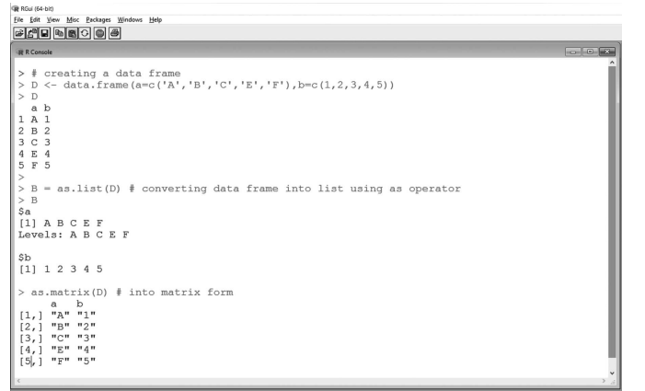
Using the ‘as’ operator to Change the structure of Data
Also, as.numeric() and as.character() functions convert characters and numbers,respectively.
The following example creates a data frame D using two vectors a and b (Figure 3.3).
Now the command ‘as.list(D)’ converts the data frame into list B.
The command ‘as.matrix(D)’ converts the data frame into a matrix.

Slide 35
Vectors
A vector can have a list of values. The values can be numbers, strings or logical. All the
values in a vector should be of the same data type.
A few points to remember about vectors in R are:
Vectors are stored like arrays in C
Vector indices begin at 1
All vector elements must have the same mode such as integer, numeric (floating point number), character (string), logical (Boolean), complex, object, etc.

Slide 36
Vectors
Let us create a few vectors.
1. Create a vector of numbers
> c(4, 7, 8)
[1] 4 7 8
The c function (c is short for combine) creates a new vector consisting of three values, viz. 4, 7 and 8.
2. Create a vector of string values.
> c(“R”, “SAS”, “SPSS”)
[1] “R” “SAS” “SPSS”
3. Create a vector of logical values.
> c(TRUE, FALSE)
[1] TRUE FALSE
A vector cannot hold values of different data types. Consider the example below on placing integer, string and Boolean values together in a vector.
> c(4, 8, “R”, FALSE)
[1] “4” “8” “R” “FALSE”

Slide 37
Sequence Vector
A sequence vector can be created with a start:end notation.
Objective
Create a sequence of numbers between 1 and 5 (both inclusive).
> 1:5
[1] 1 2 3 4 5
Or
> seq(1:5)
[1] 1 2 3 4 5
The default increment with seq is 1. However, it also allows the use of increments
other than 1.
> seq (1, 10, 2)
[1] 1 3 5 7 9
Or
> seq (from=1, to=10, by=2)
[1] 1 3 5 7 9
Or
> seq (1, 10, by=2)
[1] 1 3 5 7 9
seq can also generate numbers in the descending order.
> 10:1
[1] 10 9 8 7 6 5 4 3 2 1
> seq (10, 1, by=–2)
[1] 10 8 6 4 2

Slide 38
rep function
The rep function is used to place the same constant into long vectors.
The syntax is rep(z,k), which creates a vector of k*length(z) elements, each equals to z.
Objective
Demonstrate rep function.
Act
> rep (3, 4)
[1] 3 3 3 3
Or
> x <-rep (3, 4)
> x
[1] 3 3 3 3

Slide 39
Vector Access
Objective
Let us create a variable, ‘VariableSeq’ and assign to it a vector consisting of string values.
> VariableSeq <- c (“R”, “is”, “a”, “programming”, “language”)
Objective
To access values in a vector, specify the indices at which the value is present in the vector.
Indices start at 1.
> VariableSeq[1]
[1] “R”
> VariableSeq[2]
[1] “is”
> VariableSeq[3]
[1] “a”
> VariableSeq[4]
[1] “programming”
> VariableSeq[5]
[1] “language”

Slide 40
Vector Access
Objective
Assign new values in an existing vector.
For example, let us assign value, ‘goodprogramming’ at indices 4 in the existing vector, ‘VariableSeq’.
> VariableSeq[4] <- “good programming”
Outcome
> VariableSeq[4]
[1] “good programming”
Objective
To access more than one value from the vector.
(a) Access the first and the fifth element from the vector, ‘VariableSeq’.
> VariableSeq[c(1, 5)]
[1] “R” “language”

Slide 41
Vector Access
(b) Access first to the fourth element from the vector, ‘VariableSeq’.
> VariableSeq[1:4]
[1] “R” “is” “a” “good programming”
(c) Access the first, fourth and the fifth element from the vector, ‘VariableSeq’.
> VariableSeq[c(1, 4:5)]
[1] “R” “good programming” “language”
(d) Retrieve all the values from the variable, ‘VariableSeq’
> VariableSeq
[1] “R” “is” “a” “good programming”
[5] “language”

Slide 42
Vector Names
The names() function helps to assign names to the vector elements.
This is accomplished in two steps as shown:
> placeholder <- 1:5
> names(placeholder) <- c(“r”, “is”, “a”, “programming”, “language”)
The vector elements can then be retrieved using the indices position.
> placeholder
r is a programming language
1 2 3 4 5
> placeholder [3]
a
3

Slide 43
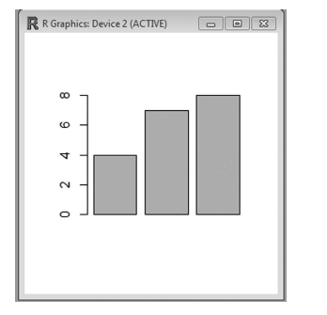
Vector Names
Objective
Plot a bar graph using the barplot function. The barplot function uses a vector’s values
to plot a bar chart.
Act
The vector used is called BarVector.
> BarVector <- c(4, 7, 8)
> barplot(BarVector)

Slide 44
Vector Math
Let us define a vector, ‘x’ with three values. Let us add a scalar value (single value) to the vector. This value will get added to each vector element.
> x <- c(4, 7, 8)
> x +1
[1] 5 8 9
However, the vector will retain its individual elements.
> x
[1] 4 7 8
If the vector needs to be updated with the new values, type the statement given below.
> x <- x + 1
> x
[1] 5 8 9
We can run other arithmetic operations on the vector as given:
> x – 1
[1] 4 7 8
> x * 2
[1] 10 16 18
> x / 2
[1] 2.5 4.0 4.5

Slide 45
Vector Recycling
If an operation is performed involving two vectors that requires them to be of the same
length, the shorter one is recycled, i.e. repeated until it is long enough to match the longer
one.
Objective
Add two vectors wherein one has length, 3 and the other has length, 6.
> c(1, 2, 3) + c(4, 5, 6, 7, 8, 9)
[1] 5 7 9 8 10 12
Objective
Multiply the two vectors wherein one has length, 3 and the other has length, 6.
> c(1, 2, 3) * c(4, 5, 6, 7, 8, 9)
[1] 4 10 18 7 16 27

Slide 46
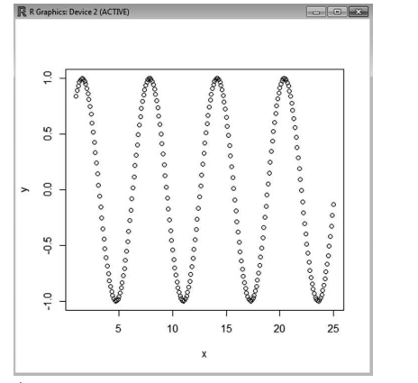
Vector Recycling
Objective
Plot a Scatter Plot.
The function to plot a scatter plot is ‘plot’. This function uses two vectors, i.e. one for the x axis and another for the y axis.
The objective is to understand the relationship between numbers and their sines.
We will use two vectors. Vector, x which will have a sequence of values between 1 and 25 at an interval of 0.1 and vector, y which stores the sines of all values held in vector, x.
> x <-seq(1, 25, 0.1)
> y <-sin(x)
The plot function takes the values in the vector, x and plots it on the horizontal axis. It then takes the values in the vector, y and places it on the vertical axis (Figure 3.4).
> plot(x, y)

Slide 47
Matrices
Matrices are nothing but two-dimensional arrays.
Objective
Let us create a matrix which is 3 rows by 4 columns and set all its elements to 1.
> matrix (1, 3, 4)
[, 1] [, 2] [, 3] [, 4]
[1, ] 1 1 1 1
[2, ] 1 1 1 1
[3, ] 1 1 1 1
Objective
Use a vector to create an array, 3 rows high and 3 columns wide.
Step 1: Begin by creating a vector that has elements from 10 to 90 with an interval of 10.
> a <- seq(10, 90, by = 10)
Step 2: Validate by printing the value of vector a.
> a
[1] 10 20 30 40 50 60 70 80 90
Step 3: Call the matrix function with vector, ‘a’ the number of rows and the number of columns.
> matrix (a, 3, 3)
[, 1] [, 2] [, 3]
[1, ] 10 40 70
[2, ] 20 50 80
[3, ] 30 60 90

Slide 48
Matrices
Objective
Re-shape the vector itself into an array using the dim function.
Step 1: Begin by creating a vector that has elements from 10 to 90 with an interval of 10.
> a <- seq (10, 90, by = 10)
Step 2: Validate by printing the value of vector, a.
> a
[1] 10 20 30 40 50 60 70 80 90
Step 3: Assign new dimensions to vector, a by passing a vector having 3 rows and 3
columns (c (3, 3)).
> dim(a) <- c(3, 3)
Step 4: Print the values of vector, a. You will notice that the values have shifted to form 3 rows by 3 columns.
The vector is no longer one dimensional. It has been converted into
a two-dimensional matrix that is 3 rows high and 3 columns wide.
> a
[, 1] [, 2] [, 3]
[1, ] 10 40 70
[2, ] 20 50 80
[3, ] 30 60 90

Slide 49
Matrix Access
Objective
Access the elements of a 3 *4 matrix.
Step 1: Create a matrix, ‘mat’, 3 rows high and 4 columns wide using a vector.
> x <- 1:12
> x
[1] 1 2 3 4 5 6 7 8 9 10 11 12
> mat <- matrix (x, 3, 4)
> mat
[, 1] [, 2] [, 3] [, 4]
[1, ] 1 4 7 10
[2, ] 2 5 8 11
[3, ] 3 6 9 12
Step 2: Access the element present in the second row and third column of the matrix, ‘mat’.
> mat [2, 3]
[1] 8
Objective
Access the third row of an existing matrix.
Step 1: Let us begin by printing the values of an existing matrix, ‘mat’
> mat
[, 1] [, 2] [, 3] [, 4]
[1, ] 1 4 7 10
[2, ] 2 5 8 11
[3, ] 3 6 9 12
Step 2: To access the third row of the matrix, simply provide the row number and omit
the column number.
> mat [3, ]
[1] 3 6 9 12

Slide 50
Matrix Access
Objective
Access the second column of an existing matrix.
Step 1: Let us begin by printing the values of an existing matrix, ‘mat’
> mat
[, 1] [, 2] [, 3] [, 4]
[1, ] 1 4 7 10
[2, ] 2 5 8 11
[3, ] 3 6 9 12
Step 2: To access the second column of the matrix, simply provide the column number
and omit the row number.
> mat[, 2]
[1] 4 5 6

Slide 51
Matrix Access
Objective
Access the second and third columns of an existing matrix.
Step 1: Let us begin by printing the values of an existing matrix, ‘mat’.
> mat
[, 1] [, 2] [, 3] [, 4]
[1, ] 1 4 7 10
[2, ] 2 5 8 11
[3, ] 3 6 9 12
Step 2: To access the second and third columns of the matrix, simply provide the column numbers and omit the row number.
> mat[,2:3]
[, 1] [, 2]
[1, ] 4 7
[2, ] 5 8
[3, ] 6 9

Slide 52
Matrix Access
Objective
Create a contour plot.
Create a matrix, ‘mat’ which is 9 rows high and 9 columns wide and assign the value ‘1’ to all its elements.
> mat <- matrix(1, 9, 9)
Print all the values of the matrix, ‘mat’.
> mat
[, 1] [, 2] [, 3] [, 4] [, 5] [, 6] [, 7] [, 8] [, 9]
[1, ] 1 1 1 1 1 1 1 1 1
[2, ] 1 1 1 1 1 1 1 1 1
[3, ] 1 1 1 1 1 1 1 1 1
[4, ] 1 1 1 1 1 1 1 1 1
[5, ] 1 1 1 1 1 1 1 1 1
[6, ] 1 1 1 1 1 1 1 1 1
[7, ] 1 1 1 1 1 1 1 1 1
[8, ] 1 1 1 1 1 1 1 1 1
[9, ] 1 1 1 1 1 1 1 1 1
Assign ‘0’ as the value to the element present in the third row and third column of the
matrix, ‘mat’.

Slide 53
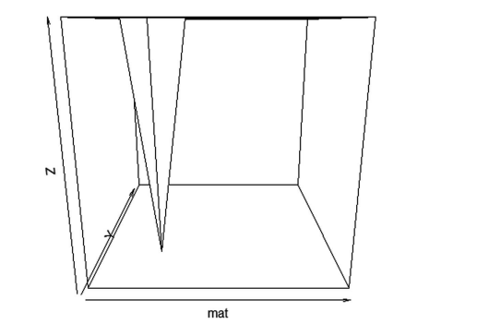
Matrix Access
Objective
Create a 3D perspective plot with the persp() function (Figure 3.6).
It provides a 3D wireframe plot most commonly used to display a surface.
>persp(mat)
We can add a title to our plot with the parameter ‘main’.
Similarly, ‘xlab’, ‘ylab’ and ‘zlab’ can be used to label the three axes. Coloring of the plot is done with parameter ‘col’. Similarly, we can add shading with the parameter ‘shade’.

Slide 54
Factors
School, ‘XYZ’ places students in groups, also called houses. Each group is assigned a unique color such as ‘red’, ‘green’, ‘blue’ or ‘yellow’. HouseColor is a vector that stores the house colors of a group of students.
> HouseColor <- c(‘red’, ‘green’, ‘blue’, ‘yellow’, red’, ‘green’, ‘blue’, ‘blue’)
> types <- factor(HouseColor)
> HouseColor
[1] “red” “green” “blue” “yellow” “red” “green” “blue” “blue”
> print(HouseColor)
[1] “red” “green” “blue” “yellow” “red” “green” “blue” “blue”
> print (types)
[1] red green blue yellow red green blue blue
Levels: blue green red yellow

Slide 55
Factors
Levels denotes the unique values.
The above has four distinct values such as ‘blue’, ‘green’, ‘red’ and ‘yellow’.
> as.integer(types)
[1] 3 2 1 4 3 2 1 1
The above output is explained as given below.
1 is the number assigned to blue.
2 is the number assigned to green.
3 is the number assigned to red.
4 is the number assigned to yellow.
> levels(types)
[1] “blue” “green” “red” “yellow”

Slide 56
List
List is similar to C Struct.
Objective
Create a list in R.
To create a list, ‘emp’ having three elements, ‘EmpName’, ‘EmpUnit’ and ‘EmpSal’.
> emp <- list (“EmpName=“Alex”, EmpUnit = “IT”, EmpSal = 55000)
Outcome
To get the elements of the list, ‘emp’ use the command given below.
> emp
$EmpName
[1] “Alex”
$EmpUnit
[1] “IT”
$EmpSal
[1] 55000

Slide 57
List
Actually, the element names, e.g. ‘EmpName’, ‘EmpUnit’ and ‘EmpSal’ are optional.
We could alternatively do this as shown below.
> EmpList <- list(“Alex”, “IT”, 55000)
> EmpList
[[1]]
[1] “Alex”
[[2]]
[1] “IT”
[[3]]
[1] 55000

Slide 58
List Tags and Values
A list has elements. The elements in a list can have names, which are referred to as tags.
Elements can also have values.
For example, in the ‘emp’ list we have three elements, viz. EmpName, EmpUnit and
EmpSal. The values are as follows. The element ‘EmpName’ has the value ‘Alex’, the
element ‘EmpUnit’ has the value ‘IT’ and
Objective
Retrieve the names of the elements in the list ‘emp’.
> names(emp)
[1] “EmpName” “EmpUnit” “EmpSal”the element ‘EmpSal’ has the value 55000.

Slide 59
List Tags and Values
Objective
Retrieve the values of the elements in the list ‘emp’.
> unlist(emp)
EmpName EmpUnit EmpSal “Alex” “IT” “55000”
The command to retrieve the value of a single element in the list ‘emp’ is given below.
Objective
Retrieve the value of the element ‘EmpName’ in the list ‘emp’.
> unlist(emp[“EmpName”])
EmpName
“Alex”
The value of the other elements in the list can be checked in a similar manner.
> unlist(emp[“EmpUnit”])
EmpUnit
“IT”
> unlist(emp[“EmpSal”])
EmpSal
55000

Slide 60
Add/Delete Element to or from a List
Before adding an element to the list ‘emp’, let us verify what elements exist in the list.
> emp
$EmpName
[1] “Alex”
$EmpUnit
[1] “IT”
$EmpSal
[1] 55000
Objective
Add an element with the name ‘EmpDesg’ and value ‘Software Engineer’ to the list, ‘emp’.
> emp$EmpDesg = “Software Engineer”
Outcome
> emp
$EmpName
[1] “Alex”
$EmpUnit
[1] “IT”
$EmpSal
[1] 55000
$EmpDesg
[1] “Software Engineer”

Slide 61
Add/Delete Element to or from a List
Objective
Delete an element with the name ‘EmpUnit’ and value ‘IT’ from the list, ‘emp’.
> emp$EmpUnit <- NULL
Outcome
> emp
$EmpName
[1] “Alex”
$EmpSal
[1] 55000
$EmpDesg
[1] “Software Engineer”

Slide 62
Size of a List
length() function can be used to determine the number of elements present in the list.
The list, ‘emp’ has three elements as shown:
> emp
$EmpName
[1] “Alex”
$EmpSal
[1] 55000
$EmpDesg
[1] “Software Engineer”
Objective
Determine the number of elements in the list, ‘emp’.
> length(emp)
[1] 3

Slide 63
Size of a List
Recursive List
A recursive list means a list within a list.
Objective
Create a list within a list.
Let us begin with two lists, ‘emp’ and ‘emp1’. The elements in both the lists are as shown below.
> emp
$EmpName
[1] “Alex”
$EmpSal
[1] 55000
$EmpDesg
[1] “Software Engineer”
> emp1
$EmpUnit
[1] “IT”
$EmpCity
[1] “Los Angeles”
We would like to combine both the lists into a single list called ‘EmpList’.
> EmpList <- list(emp, emp1)

Slide 64
Size of a List
Outcome
> EmpList
[[1]]
[[1]] $EmpName
[1] “Alex”
[[1]]$EmpSal
[1] 55000
[[1]]$EmpDesg
[1] “Software Engineer”
[[2]]
[[2]]$EmpUnit
[1] “IT”
[[2]]$EmpCity
[1] “Los Angeles”

Slide 65
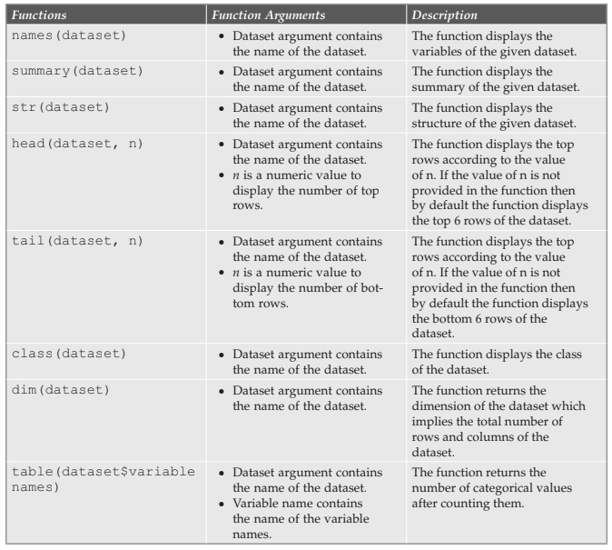
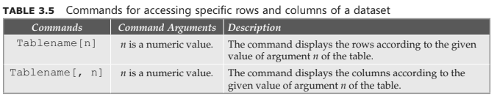
Few Common analytical tasks
Reading, writing, updating and merging data are common operations in any programming language.
These are used for processing data. All programming languages work with different types of data like numeric, characters, logical, etc.
1) Exploring a Dataset
Table 3.4 describes some functions for exploring a dataset.

Slide 66
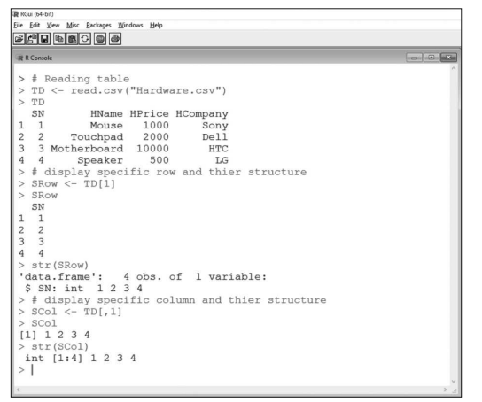
Few Common analytical tasks
2)Conditional Manipulation of a Dataset
Analytical data processing sometimes may require specific rows and columns of a dataset.
Table 3.5 lists commands that can be used for accessing specific rows and columns of
a dataset.

Slide 67
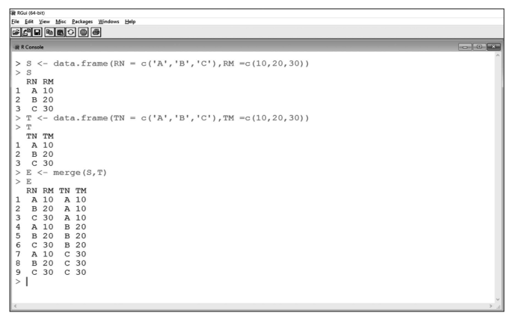
Merging Data
Merging different datasets or objects is another common task used in most processing
activities. Analytical data processing may also require merging two or more data objects. R
provides a function merge() that merges data objects. The merge() function combines data
frames by common columns or row names. It also follows the database join operations.
The syntax of the merge() function is given as follows:
merge(x, y,...) OR
merge(x, y, by = intersect(names(x), names(y)), by.x = by, by.y =
by, all = FALSE, all.x = all, all.y = all, ...)

Slide 68
Unit-III
Aggregating and Group Processing of a Variable , aggregate()
Simple Analysis Using :Input,Describe Data Structure,Describe Variable Structure, Output
Methods for Reading Data :CSV and Spreadsheets ,Reading Data from PackageS,Reading Data from Web/APIs Reading a JSON (Java Script Object Notation) Document ,Reading an XML File
Comparison of R GUIs for Data Input 106
Using R with Databases and Business Intelligence Systems:RODBC Using MySQL and R
Using PostgreSQL and R ,Using SQLite and R,Using JasperDB and R,Using Pentaho and R

Slide 69
Aggregating and group Processing of a Variable
Aggregate and group operations aggregate the data of specific variables of a dataset after
grouping variable data. Like merging, analytical data processing also requires aggregation
and grouping operation on a dataset. R provides some functions for aggregation operation.
The next section describes two functions aggregate() and tapply() of R.

Slide 70
aggregate() Function
The aggregate() function is an inbuilt function of R that aggregates data values.
The function also splits data into groups after performing given statistical functions.
The syntax of the aggregate() function is
aggregate(x, ...) or
aggregate(x, by, FUN, ...)
where, x is an object, by argument defines the list of group elements of the specific variable
of the dataset, FUN argument is a statistic function that returns a numeric value after
given statistic operations and the dots ‘...’ define the other optional argument.

Slide 71
tapply() Function
The tapply() function is also an inbuilt function of R and works in a manner similar
to the function aggregate().
The function aggregates the data values into groups after performing the given statistical functions.
The syntax of the tapply () function is
tapply (x, ...) or
tapply(x, INDEX, FUN, ...)
where, x is an object that defines the summary variable, INDEX argument defines the
list of group elements—also called group variable, FUN argument is a statistic function
that returns a numeric value after given statistic operations and the dots ‘...’ define the
other optional argument.

Slide 72
Simple analysis using R
You will learn how to read data from a dataset, perform a common operation and see the output.
Input
Input is the first step in any processing, including analytical data processing. Here, the
input is dataset, ‘Fruit’. For reading the dataset into R, use read.table() or read.csv()
function.
Describe Data Structure
After reading the dataset into the R workspace, the dataset can be described using different
functions like names(), str(), summary(), head() and tail().

Slide 73
Simple analysis using R
Describe Variable Str
After describing the dataset, you can also describe the variables of the dataset using
different functions. For describing the variables and performing operations on them,
many functions are available.
Methods for reading Data
R supports different types of data formats related to a database. With the help of import
and export utility of R, any type of data can be imported and exported into R. In this
section, you will learn about the different methods used for reading data.

Slide 74
Simple analysis using R
CSV and Spreadsheets
Comma separated value (CSV) files and spreadsheets are used for storing small size data.
R has an inbuilt function facility through which analysts can read both types of files.
Reading CSV Files
A CSV file uses .csv extension and stores data in a table structure format in any plain text.
The following function reads data from a CSV file:
read.csv(‘filename’)
where,
filename is the name of the CSV file that needs to be imported.

Slide 75
Methods for Reading Data
The read.table() function can also read data from CSV files.
The syntax of the function is
read.table(‘filename’, header=TRUE, sep=‘,’,...)
where,
filename argument defines the path of the file to be read, header argument contains
logical values TRUE and FALSE for defining whether the file has header names on the
first line or not, sep argument defines the character used for separating each column of
the file and the dots ‘...’ define the other optional arguments.

Slide 76
Methods for Reading Data
Reading Spreadsheets
A spreadsheet is a table that stores data in rows and columns.
An Excel file uses .xlsx extension and stores data in a spreadsheet.
The syntax of the read.xlsx() function is
read.xlsx(‘filename’,...)
where,
filename argument defines the path of the file to be read and the dots ‘...’ define the
other optional arguments.

Slide 77
Reading Data from Packages
A package is a collection of functions and datasets. In R, many packages are available for
doing different types of operations. Some functions for reading and loading the dataset from and into
packages defined in R are explained next.
library() Function
The library() function loads packages into the R workspace. It is compulsory to import
the package before reading the available dataset of that package. The syntax of the
library() function is:
library(packagename)
where,
packagename argument is the name of the package to be read.

Slide 78
Reading Data from Packages
data() Function
The data() function lists all the available datasets of the loaded package into the R
workspace. For loading a new dataset into the loaded packages, users need to pass the
name of the new dataset into data() function. The syntax of the data() function is:
data(datasetname)
where,
datasetname argument is the name of the dataset to be read.

Slide 79
Comparison of R GUIs for Data input
R is mainly used for statistical analytical data processing. Analytical data processing needs
a large dataset that is stored in a tabular form. Sometimes it is difficult to use inbuilt
functions of R for doing such analytical data processing operations in R console. Hence,
to overcome this problem, GUI is developed for R.
Graphical user interface is a graphical medium through which users interact with the
language or perform operations. Different GUIs are available for data input in R. Each
GUI has its own features.

Slide 80
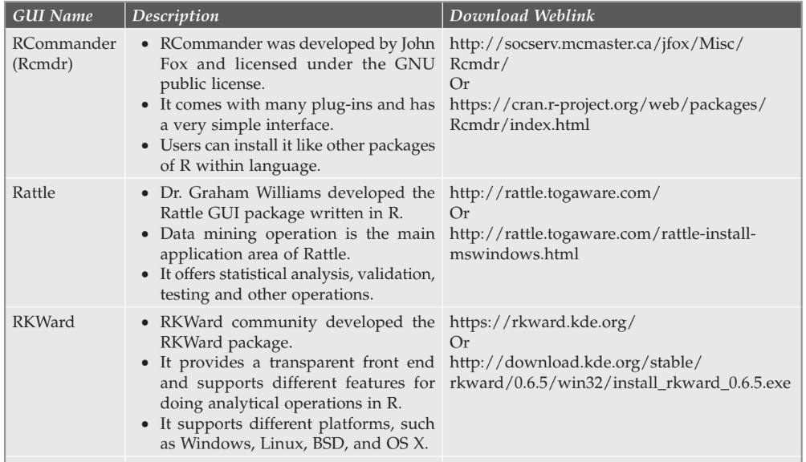
GUI

Slide 81
Using R with Databases and Business intelligence systems
Business analytical processing uses database for storing large volume of information.
Business intelligence systems or business intelligence tools handle all the analytical
processing of a database and use different types of database systems.
The tools support the relational database processing (RDBMS), accessing a part of the large database, getting a summary of the database, accessing it concurrently, managing security, constraints, server connectivity and other functionality.
At present, different types of databases are available in the market for processing.
They have many inbuilt tools, GUIs and other inbuilt functions through which database processing becomes easy.
learn about database connection with SQL, MySQL, PostGreSQL and SQL Lite database as R provides inbuilt packages to access all of these.

Slide 82
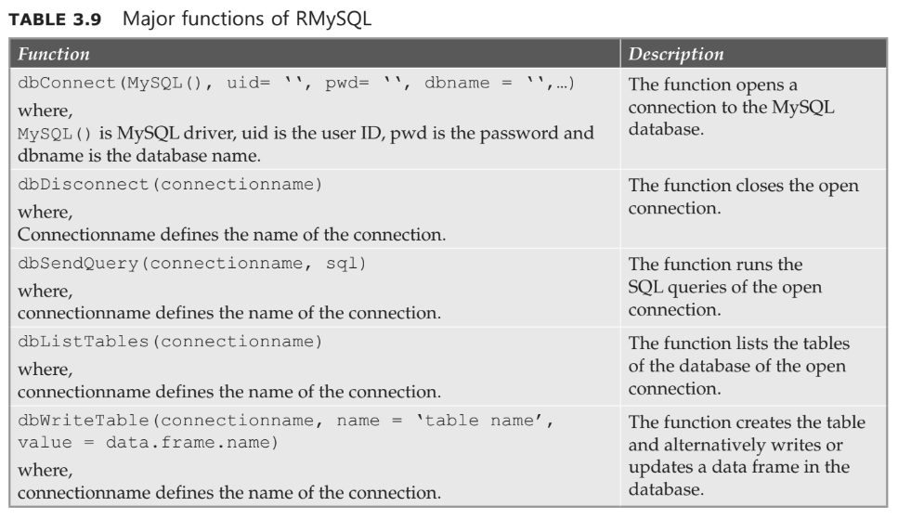
Major Functions of RMySQL

Slide 83
Chapter 4: Exploring Data in R
Introduction
R provides interactive data visualisations to support analyses of statistical data.
In R, data is usually stored in data frames owing to its ability to hold data of varied data types.
These data frames are unlike the matrices, which can store data of only one type.
we will begin by learning about data frames and gradually progress to read in data from
.csv, tab separated value files, tables, etc., into data frames.
Finally, we will explore data using various functions and interactive visualisations provided by R.

Slide 84
Data Frames
It has a specific number of columns, each of which is expected to contain values of a particular data type.
It also has an indeterminate number of rows, i.e. sets of related values for each column.
Assume, we have been asked to store data of our employees (such as employee ID, name and the project that they are working on).
We have been given three independent vectors, viz., namely, “EmpNo”, “EmpName” and “ProjName” that holds details such as employee ids, employee names and project names, respectively.

Slide 85
Data Frames
>EmpNo <- c(1000, 1001, 1002, 1003, 1004)
>EmpName <- c(“Jack”, “Jane”, “Margaritta”, “Joe”, “Dave”)
>ProjName <- c(“PO1”, “PO2”, “PO3”, “PO4”, “PO5”)
However, we need a data structure similar to a database table or an Excel spreadsheet
that can bind all these details together.
We create a data frame by the name, “Employee”to store all the three vectors together.
>Employee <- data.frame(EmpNo, EmpName, ProjName)

Slide 86
Data Frames
Let us print the content of the date frame, “Employee”.
> Employee
EmpNo EmpName ProjName
1 1000 Jack PO1
2 1001 Jane PO2
3 1002 Margaritta PO3
4 1003 Joe PO4
5 1004 Dave PO5

Slide 87
Data Frame Access
There are two ways to access the content of data frames:
i. By providing the index number in square brackets
ii. By providing the column name as a string in double brackets.
By Providing the Index Number in Square Brackets
Example 1
To access the second column, “EmpName”, we type the following command at the R
prompt.
> Employee[2]
EmpName
1 Jack
2 Jane
3 Margaritta
4 Joe
5 Dave

Slide 88
Data Frame Access
Example 2
To access the first and the second column, “EmpNo” and “EmpName”, we type the
following command at the R prompt.
> Employee[1:2]
EmpNo EmpName
1 1000 Jack
2 1001 Jane
3 1002 Margaritta
4 1003 Joe
5 1004 Dave

Slide 89
Data Frame Access
Example 3
> Employee [3,]
EmpNo EmpName ProjName
3 1002 Margaritta PO3
Example 4
Let us define row names for the rows in the data frame.
> row.names(Employee) <- c(“Employee 1”, “Employee 2”, “Employee 3”,
“Employee 4”, “Employee 5”)
> row.names (Employee)
[1] “Employee 1” “Employee 2” “Employee 3” “Employee 4” “Employee 5”
> Employee
EmpNo EmpName ProjName
Employee 1 1000 Jack P01
Employee 2 1001 Jane P02
Employee 3 1002 Margaritta P03
Employee 4 1003 Joe P04
Employee 5 1004 Dave P05

Slide 90
Ordering the Data Frames
Let us display the content of the data frame, “Employee” in ascending order of
“EmpExpYears”.
> Employee[order(Employee$EmpExpYears),]
EmpNo EmpName ProjName EmpExpYears
1 1000 Jack P01 5
3 1002 Margaritta P03 6
5 1004 Dave P05 7
2 1001 Jane P02 9
4 1003 Joe P04 12

Slide 91
Use the syntax as shown next to display the content of the data frame, “Employee” in
descending order of “EmpExpYears”.
> Employee[order(-Employee$EmpExpYears),]
EmpNo EmpName ProjName EmpExpYears
4 1003 Joe P04 12
2 1001 Jane P02 9
5 1004 Dave P05 7
3 1002 Margaritta P03 6
1 1000 Jack P01 5

Slide 92
R Functions For unDerstanDing Data in Data Frames
We will explore the data held in the data frame with the help of the following R
functions:
d dim()
r nrow()
r ncol()
d str()
d summary()
d names()
d head()
d tail()
d edit()

Slide 93
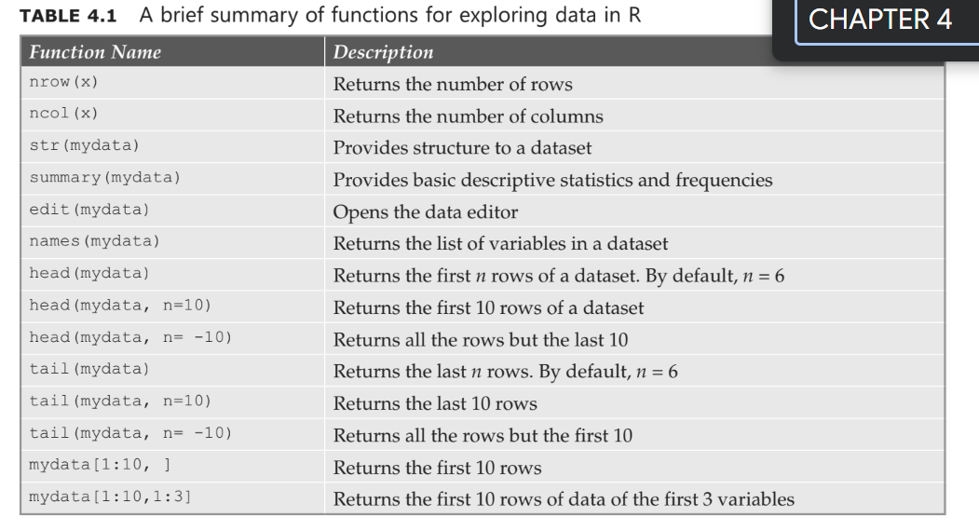

Slide 94
LoaD Data Frames
Reading from a
Let us load this file using the read.csv function.
> ItemDataFrame <- read.csv(“D:/item.csv”)
> ItemDataFrame
Itemcode ItemCategory ItemPrice
1 I1001 Electronics 700
2 I1002 Desktop supplies 300
3 I1003 Office supplies 350 .csv (comma separated values file)

Slide 95
Subsetting Data Frame
To subset the data frame and display the details of only those items whose price is greater
than or equal to 350.
> subset(ItemDataFrame, ItemPrice >=350)
Itemcode ItemCategory ItemPrice
1 I1001 Electronics 700
3 I1003 Office supplies 350
To subset the data frame and display only the category to which the items belong (items
whose price is greater than or equal to 350).
> subset(ItemDataFrame,ItemPrice >=350, select = c(ItemCategory))
ItemCategory
1 Electronics
3 Office supplies

Slide 96
To subset the data frame and display only the items where the category is either “Office
supplies” or “Desktop supplies”.
> subset(ItemDataFrame, ItemCategory == “Office supplies” | ItemCat-
egory == “Desktop supplies”)
Itemcode ItemCategory ItemPrice
2 I1002 Desktop supplies 300
3 I1003 Office supplies 350

Slide 97
Reading from a Tab Separated Value File
For any file that uses a delimiter other than a comma, one can use the read.table command.
Example
We have created a tab separated file by the name, “item-tab-sep.txt” in the D:\ drive. It
has the following content.
Itemcode ItemQtyOnHand ItemReorderLvl
I1001 75 25
I1002 30 25
I1003 35 25

Slide 98
Example
For any file that uses a delimiter other than a comma, one can use the read.table command.
Example
We have created a tab separated file by the name, “item-tab-sep.txt” in the D:\ drive. It
has the following content.
Itemcode ItemQtyOnHand ItemReorderLvl
I1001 75 25
I1002 30 25
I1003 35 25

Slide 99
Example
Now let us read the content of the specified file into the data frame, “ItemDataFrame”.
> ItemDataFrame <- read.table(“D:/item-tab-sep.txt”,sep=“\t”,
header=TRUE)
> ItemDataFrame
Itemcode ItemQtyOnHand ItemReorderLvl
1 I1001 70 25
2 I1002 30 25
3 I1003 35 25

Slide 100
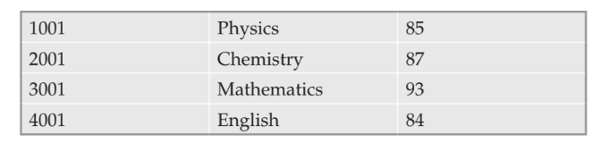
Reading from a Table
A data table can reside in a text file. The cells inside the table are separated by blank
characters. An example of a table with 4 rows and 3 columns is given as follows:
Copy and paste the table in a file named “d:/mydata.txt” with a text editor and then
load the data into the workspace with the function read.table.
> mydata = read.table(“d:/mydata.txt”)
> mydata
V1 V2 V3
1 1001 Physics 85
2 2001 Chemistry 87
3 3001 Mathematics 93
4 4001 English 84

Slide 101
Merging Data Frames
Let us now attempt to merge two data frames using the merge function. The merge
function takes an x frame (item.csv) and a y frame (item-tab-sep.txt) as arguments. By default, it joins the two frames on columns with the same name (the two “Itemcode”
columns).
> csvitem <- read.csv(“d:/item.csv”)
> tabitem <- read.table(“d:/item-tab-sep.txt”,sep=“\t”,header=TRUE)
> merge (x=csvitem, y=tabitem)
Itemcode ItemCategory ItemPrice ItemQtyOnHand ItemReorderLvl
1 I1001 Electronics 700 70 25
2 I1002 Desktop supplies 300 30 25
3 I1003 Office supplies 350 35 25

Slide 102
Exploring Data
Data in R is a set of organised information. Statistical data type is more common in R,
which is a set of observations where values for the variables are passed. These input
variables are used in measuring, controlling or manipulating the results of a program.
Each variable differs in size and type. R supports the following basic data types to explore:
Integer
Numeric
Logical
Character/string
Factor
Complex
Data types have been covered in Chapter 2. Based on the specific data characteristics
in R, data can be explored in different ways. You will learn about these methods in the
following section.

Slide 103
Exploratory Data Analysis
Exploratory data analysis (EDA) involves dataset analysis to summarise the main
characteristics in the form of visual representations. Exploratory data analysis using R is
an approach used to summarise and visualise the main characteristics of a dataset, which
differs from initial data analysis.

Slide 104
Exploratory Data Analysis
The main aim of EDA is to summarise and visualise the main characteristics of a dataset.
It focuses on:
Exploring data by understanding its structure and variables
Developing an intuition about the dataset
Considering how the dataset came into existence
Deciding how to investigate by providing a formal statistical method
Extending better insights about the dataset
Formulating a hypothesis that leads to new data collection
Handling any missing values
Investigating with more formal statistical methods.

Slide 105
Exploratory Data Analysis
Some of the graphical techniques used by EDA are:
Box plot
Histogram
Scatter plot
Run chart
Bar chart
Density plots
Pareto chart

Slide 106
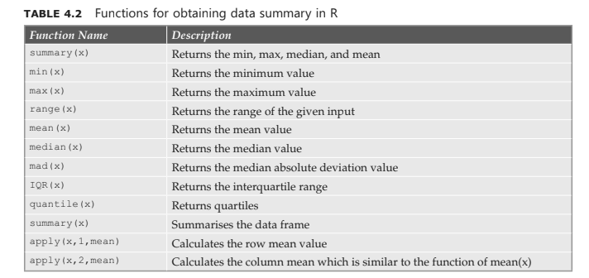
Data summary
Data summary in R can be obtained by using various R functions. Table 4.2 provides a
brief overview of few R functions.

Slide 107
Example
We will execute few R functions on the data set, “Employee”. Let us begin by displaying
the contents of the dataset, “Employee”.
> Employee
EmpNo EmpName ProjName EmpExpYears
1 1000 Jack P01 5
2 1001 Jane P02 9
3 1002 Margaritta P03 6
4 1003 Joe P04 12
5 1004 Dave P05 7

Slide 108
Example
The summary(Employee[4]) function works on the fourth column, “EmpExpYears” and computes the minimum, 1st quartile, median, mean, 3rd quartile and maximum for
its value.
> summary(Employee[4])
EmpExpYears
Min. : 5.0
1st Qu. : 6.0
Median : 7.0
Mean : 7.8
3rd Qu. : 9.0
Max. : 12.0

Slide 109
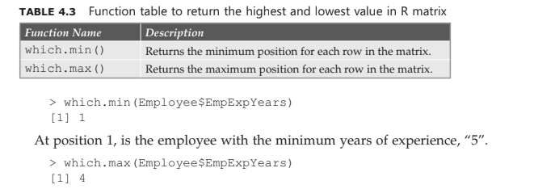
Functions

Slide 110
Finding the missing Values
In R, missing data is indicated as NA in the dataset, where NA refers to “Not Available”.
It is neither a string nor a numeric value, but it is used to specify the missing data. Input
vectors can be created with the missing values as follows:
x <- c(2,5,86,9,NA,45,3)
y <- c(“red”,NA,“NA”)
In this case, x contains numeric values as the input. Here, NA can be used to avoid any errors or other numeric exceptions like infinity.
In the second example, y contains the string values as the input.

Slide 111
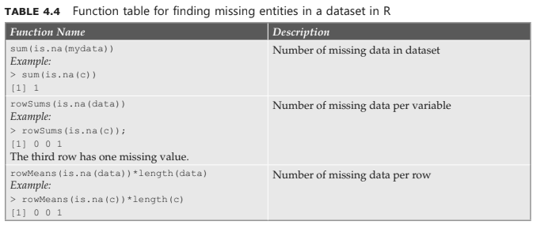
Finding the missing Values

Slide 112
Invalid Values and outliers
In R, special checks are conducted for handling invalid values.
An invalid value can be NA, NaN, Inf or -Inf.
Functions for these invalid values include anyNA(x), anyInvalid(x) and is.invalid(x), where the value of x can be a vector, matrix or array.
Here, anyNA function returns a TRUE value if the input has any Na or NaN values. Else, it returns a FALSE value. This function anyInvalid function returns a TRUE value, if the input has any invalid values. Else, it returns a FALSE value.
This function is equivalent to any(is.na(x)). anyInvalid function returns a TRUE value, if the input has any invalid values. Else, it returns a FALSE value. This function is equivalent to any(is.valid(x)).
Unlike the other two functions, is.invalid returns an object corresponding to each input value. If the input is invalid, it returns TRUE, else it returns FALSE.
This function is also equivalent to (is.na(x) | is.infinite(x)).

Slide 113
Examples
Few examples with the above functions are:
> anyNA(c(-9,NaN,9))
[1] TRUE
is.finite(c(-9, Inf,9))
> is.finite(c(-9, Inf,9))
[1] TRUE FALSE TRUE
is.infinite(c(-9, Inf,9))
> is.infinite(c(-9, Inf, 9))
[1] FALSE TRUE FALSE
is.nan(c(-9, Inf,9))
> is.nan(c(-9, Inf, 9))
[1] FALSE FALSE FALSE
> is.nan(c(-9, Inf, NaN))
[1] FALSE FALSE TRUE

Slide 114
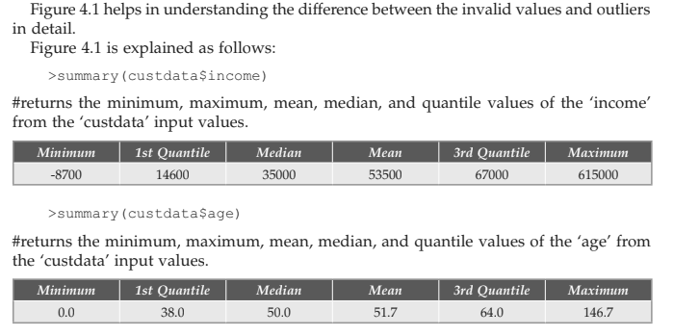
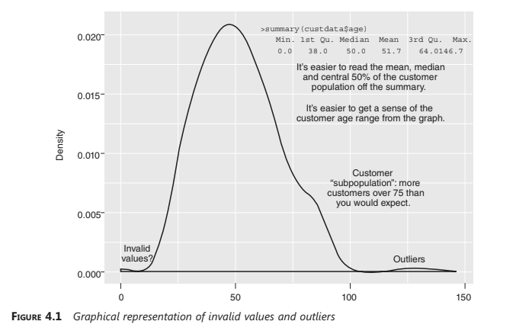
Invalid Values and outliers
The basic idea of invalid values and outliers can be explained with a simple example.
Obtain the min, max, median mean, 1st quantile, 3rd quantile values using the summary()
function.

Slide 115
Descriptive statistics
Data Range
Data range in R helps in identifying the extent of difference in input data. The data range of the observation variable is the difference between the largest and the smallest data value in a dataset. The value of a data range can be calculated by subtracting the smallest value from the largest value, i.e. Range = Largest value – Smallest value.
For example, the range or the duration of rainfall can be computed as
# Calculates the duration.
>duration = time$rainfall
#Apply max and min function to return the range
>max(duration) - min(duration)

Slide 116
Descriptive statistics
Frequency
Frequency is a summary of data occurrence in a collection of non-overlapping types. In R, freq function can be used to find the frequency distribution of vector inputs. In the example given, consider sellers as the dataset and the frequency distribution of the shopvariable is the summary of the number of sellers in each shop.
> head(subset(mtcars, select = ‘gear’))
gear
Mazda RX4 4
Mazda RX4 Wag 4
Datsun 710 4
Hornet 4 Drive 3
Hornet Sportabout 3
Valiant 3
> factor(mtcars$gear)
[1] 4 4 4 3 3 3 3 4 4 4 4 3 3 3 3 3 3 4 4 4 3 3 3 3 3 4 5 5 5 5 5 4
Levels: 3 4 5
> w = table(mtcars$gear)
> w
3 4 5
15 12 5
> t = as.data.frame(w)
> t
Var1 Freq
1 3 15
2 4 12
3 5 5
> names(t) [1] = ‘gear’
> t
gear Freq
1 3 15
2 4 12
3 5 5
The cbind()function can be used to display the result in column format.
> w
3 4 5
15 12 5
> cbind(w)
w
3 15
4 12
5 5

Slide 117
Descriptive statistics
Mode
Mode is similar to frequency, except that the value of mode returns the highest number of occurrences in a dataset. Mode can take both numeric and character as input data. Mode does not have any standard inbuilt function to calculate mode of the given inputs. A sample code to return the mode value is
#Create the function
getmode <- function(y){
uniqy <- unique(y)
uniqy[which.max(tabulate(match(y,uniqy)))]
}
# Define the input vector values
v <- c(5,6,4,8,5,7,4,6,5,8,3,2,1)
#Calculate the mode with user-defined functions
resultmode<- getmode(v)
print(resultmode)
#Define characters as input vector values
charv <-c(“as”,“is”,“is”,“it”,“in”)
#Calculate mode using user-defined function
resultmode <- getmode(charv)
print(resultmode)
Mean and Median
Statistical data in R is analysed using inbuilt functions. These inbuilt functions are found in the base R package. The functions take vector values as input with arguments and produce the output.
Mean
Mean is the sum of input values divided by the sum of the number of inputs. It is also called the average of the input values. In R, mean is calculated by inbuilt functions. The
function mean() gives the output of the mean value in R.
Basic syntax for the mean() function in R is:
mean(x, trim=0, na.rm = FALSE,...)
where,
x is the input vector, trim specifies some drop in observations from both the sorted ends of the input vector and na.rm removes the missing values in the input vector.

Slide 118
Example -Mean
A sample code to calculate the mean in R is
#Define a vector
x<- c(15,54,6,5,9.2,36,5.3,8,-7,-5)
# Find the mean of the vector inputs
result.mean <- mean(x)
print(result.mean)
Output
On execution, it would produce an output value of [1]12.65.
> x<- c(15,54,6,5,9.2,36,5.3,8,-7,-5)
> result.mean <- mean(x)
> print (result.mean)
[1] 12.65
When the trim parameter is selected, it sorts the vector values first and drops the input values for calculating the mean based on the trim value from both the ends. Say trim = 0.4, 4 values from both the ends of sorted vector values are dropped.
Example 2
#Define a vector
x<- c(15,54,6,5,9.2,36,5.3,8,-7,-5)
# Find the mean of the vector inputs
result.mean <- mean(x, trim =0.3)
print(result.mean)
Output
On execution, it would produce an output value of[1] 7.125
> x<- c(15,54,6,5,9.2,36,5.3,8,-7,-5)
> result.means <- mean(x, trim =0.3)
> print(result.mean)
[1] 7.125

Slide 119
Example -Mean
Example 3
In case of any missing value, the mean() function would return NA. In order to overcome such cases, na.rm = TRUE is used to remove the NA values from the list for calculating the mean in R.
#Define a vector
x<- c(15,54,6,5,9.2,36,5.3,8,-7,-5,NA)
# Find the mean of the vector inputs
result.mean <- mean(x)
print(result.mean)
#Dropping NA values from finding the mean
result.mean <- mean(x, na.rm=TRUE)
print(result.mean)
Output
On execution, it would produce an output value of
[1]NA
[1]12.65
Example 4
Objective: To determine the mean of a set of numbers. To plot the numbers in a barplot and have a straight line run through the plot at the mean.
Step 1: To create a vector, “numbers”.
> numbers <-c(1, 3, 5, 2, 8, 7, 9, 10)
Step 2: To compute the mean value of the set of numbers contained in the vector, “numbers”.
> mean (numbers)
[1] 5.625
Outcome: The mean value for the vector, “numbers” is computed as 5.625.
Step 3: To plot a bar plot using the vector, “numbers”.
>barplot(numbers)

Slide 120
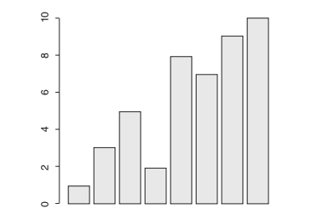
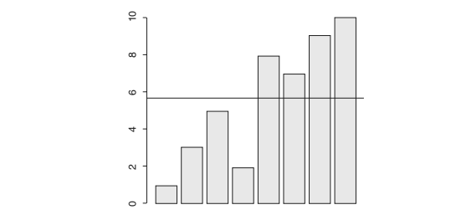
Example -Mean
Step 4: Use the abline function to have a straight line (horizontal line) run through the bar plot at the mean value. The abline function can take an h parameter with a value to draw a horizontal line or a v parameter for a vertical line. When it’s called, it updates the previous plot. Draw a horizontal line across the plot at the mean.
> barplot (numbers)
> abline (h = mean (numbers))
Outcome: A straight line at the computed mean value (5.625) runs through the bar plot
computed on the vector, “numbers”.

Slide 121
Median
Median
Median is the middle value of the given inputs. In R, the median can be found using the median() function. Basic syntax for calculating the median in R is median(x, na.rm=FALSE) where, x is the input vector value and na.rm removes the missing values in the input vector.
Example 1
A sample to find out the median value of the input vector in R is
#Define a vector
x<- c(15,54,6,5,9.2,36,5.3,8,-7,-5)
# Find the median value
median.result <-median(x)
print(median.result)
On execution, it would produce an output value of [1]7.

Slide 122
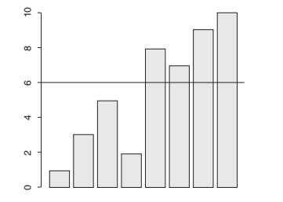
Example-Median
Example 2
Objective: To determine the median of a set of numbers. To plot the numbers in a barplot and have a straight line run through the plot at the median.
Step 1: To create a vector, “numbers”.
> numbers <- c(1, 3, 5, 2, 8, 7, 9, 10)
Step 2: To compute the median value of the set of numbers contained in the vector, “numbers”.
> median(numbers)
[1] 6
Step 3: To plot a bar plot using the vector, “numbers”. Use the abline function to have a straight line (horizontal line) run through the bar plot at the median.
> barplot (numbers)
>abline(h=median(“numbers”)
Outcome: A straight line at the computed median value (6.0) runs through the bar plot computed on the vector, “numbers”.

Slide 123
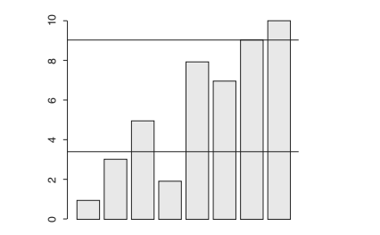
Standard Deviation
Objective: To determine the standard deviation. To plot the numbers in a bar plot and have a straight line run through the plot at the mean and another straight line run through the plot at mean + standard deviation.
Step 1: To create a vector, “numbers”.
> numbers <- c(1,3,5,2,8,7,9,10)
Step 2: To compute the mean value of the set of numbers contained in the vector, “numbers”.
> mean(numbers)
[1] 5.625
Step 3: To determine the standard deviation of the set of numbers held in the vector, “numbers”.
> deviation <- sd(numbers)
> deviation
[1] 3.377975
Step 4: To plot a bar plot using the vector, “numbers”.
> barplot (numbers)
Step 5: Use the abline function to have a straight line (horizontal line) run through the bar plot at the mean value (5.625) and another straight line run through the bar plot at
mean value + standard deviation (5.625 + 3.377975)
> barplot (numbers)
>abline (h=sd(numbers))
>abline (h=sd(numbers)) +mean(numbers))

Slide 124
Mode
Objective: To determine the mode of a set of numbers. R does not have a standard inbuilt
function to determine the mode. We will write out own, “Mode” function. This function
will take the vector as the input and return the mode as the output value.
Step 1: Create a user-defined function, “Mode”.
Mode <- function(v) {
UniqValue <- unique(v)
UniqValue[which.max(tabulate(match(v, UniqValue)))]
}
> Mode <-function(v) {
+ UniqValue <- unique(v)
+ UniqValue[which.max(tabulate(match(v, UniqValue)))]
+ }

Slide 125
Mode
While writing the above function, “Mode”, we have used three other functions provided
by R, viz. “unique”, “tabulate” and “match”.
unique function: The “unique” function will take the vector as the input and returns the
vector with the duplicates removed.
> v
[1] 2 1 2 3 1 2 3 4 1 5 5 3 2 3
> unique(v)
[1] 2 1 3 4 5
match function: Takes a vector as the input and returns the vector that has the position
of (first) match of its first arguments in its second.
> v
[1] 2 1 2 3 1 2 3 4 1 5 5 3 2 3
> UniqValue <- unique(v)
> UniqValue
[1] 2 1 3 4 5
> match(v,UniqValue)
[1] 1 2 1 3 2 1 3 4 2 5 5 3 1 3
tabulate function: Takes an integer valued vector as the input and counts the number of
times each integer occurs in it.
> tabulate(match(v,UniqValue))
[1] 4 3 4 1 2
Going by our example, “2” occurs four times, “1” occurs three times, “3” occurs four
times, “4” occurs one time and “5” occurs two times.

Slide 126
Mode
Step 2: Create a vector, “v”.
> v <- c(2,1,2,3,1,2,3,4,1,5,5,3,2,3)
Step 3: Call the function, “Mode” and pass the vector, “v” to it.
> Output <- Mode(v)
Step 4: Print out the mode value of the vector, “v”.
> print(Output)
[1] 2
Let us pass a character vector, “charv” to the “Mode” function.
Step 1: Create a character vector, “charv”.
> charv <- c(“o”,“it”,“the”,“it”,“it”)
Step 2: Call the function, “Mode” and pass the character vector, “charv” to it.
> Output <- Mode(charv)
Step 3: Print out the mode value of the vector, “v”.
> print(Output)
[1] “it”

Slide 127
Unit -V

Slide 128
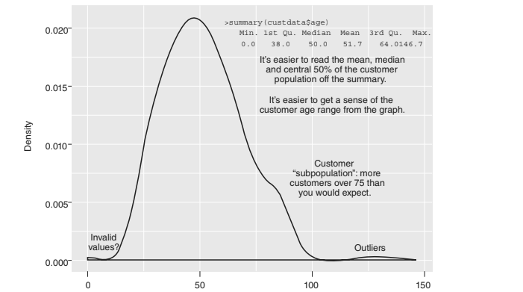
Spotting problems in Data With Visualisation
For a better understanding of input data, pictures or charts are preferred over text.
Visualisation engages the audience well and numerical values, on comparison, cannot represent a big dataset in an engaging manner.
From Figure 4.1, we observe that the graph represents the density of data with respect to the age of the customers. The use of graphical representation to examine the given set of data is called visualisation.
With this visualisation, it is easier to calculate the following:
To determine the peak value of the age of the customers (maximum value)
To estimate the existence of the sub-population
To determine the outlier values.
The graphical representation displays the maximum available information from the
lowest to the highest value.
It also presents users with greater data clarity. For better usage of visualisation, the right aspect ratio and scaling of data is needed.

Slide 129
Visually Checking Distributions for a Single Variable
With R visualisation, one can answer the following questions:
What is the peak value of the standard distribution?
How many peaks are there in a distribution? (Basically bimodality vs unimodality)
Is it normal data or lognormal data?
How does the given data vary?
Is the given data concerned in a certain interval or category?

Slide 130
Histograms
A histogram is a graphical illustration of the distribution of numerical data in successive numerical intervals of equal sizes.
It looks similar to a bar graph. However, values are grouped into continuous ranges in a histogram.
The height of a histogram bar represents the number of values occurring in a particular range. R uses hist(x) function to create simple histograms, where x is a numeric value to be plotted. Basic syntax to create a histogram using R is:
hist(v,main,xlab,xlim,ylim,breaks,col,border)
where, v takes a vector that contains numeric values, ‘main’ is the main title of the bar chart, xlab is the label of the X-axis, xlim specifies the range of values on the X-axis, ylim specifies the range of values on the Y-axis, ‘breaks’ control the number of bins or mentions the width of the bar, ‘col’ sets the colour of the bars and ‘border’ sets the border colour of the bars.

Slide 131
Example 1
A simple histogram can be created by just providing the input vector where other
parameters are optional.
# Create data for the histogram
h<- c (8,13,30,5,28)
#Create histogram for H
hist(h)

Slide 132
Example 2
A histogram simple can be created by providing the input vector “v”, file name, label for
X-axis “xlab”, colour “col” and colour “border” as shown:
# Create data for the histogram
H <- c (8,13,30,5,28)
# Give a file name for the histogram
png(file = “samplehistogram.png”)
#Create a sample histogram
hist(H, xlab=“Categories”, col=“red”)
#Save the sample histogram file
dev.off()

Slide 133
Density Plots
A density plot is referred to as a ‘continuous histogram’ of the given variable. However,
the area of the curve under the density plot is equal to 1. Therefore, the point on the
density plot diagram matches the fraction of the data (or the percentage of the data which
is divided by 100 that takes a particular value). The resulting value of the fraction is very
small.
A density plot is an effective way to assess the distribution of a variable. It provides a
better reference in finding a parametric distribution. The basic syntax to create a plot is
plot(density(x)), where x is a numeric vector value.

Slide 134
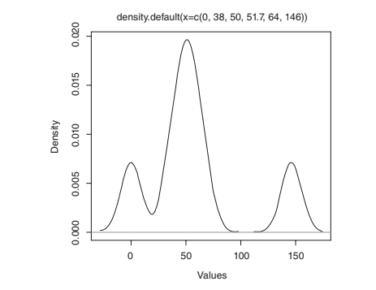
Example 1
A simple density plot can be created by just passing the values and using the plot()
function (Figure 4.5).
# Create data for the density plot
h <- density (c(0.0, 38.0, 50.0, 51.7, 64.0, 146.0))
#Create density plot for h
plot(h)
> h <- density (c(0.0, 38.0, 50.0, 51.7, 64.0, 146.0))
> plot(h, xlab=“Values”, ylab=“Density”)

Slide 135
Bar Charts
R uses the barplot() function to create a bar chart. The basic syntax for creating a
bar chart using R is
barplot(H, xlab, ylab, main, names.arg, col)
Some basic bar charts commonly used in R are:
Simple bar chart
Grouped bar chart
Stacked bar chart
1. Simple Bar Chart
A simple bar chart is created by just providing the input values and a name to the bar
chart. The following code creates and saves a bar chart using the barplot() function in R.

Slide 136
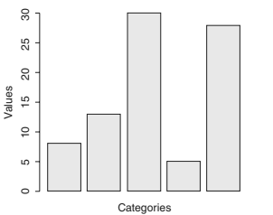
Example 1
# Create data for the bar chart
H <- c (8,13,30,5,28)
#Give a name for the bar chart
png(file = “samplebarchart.png”)
#Plot bar chart using barplot() function
barplot(H)
#Save the file
dev.off()
> H <- c (8,13,30,5,28)
> barplot (H, xlab = “Categories”, ylab=“Values”, col=“blue”)

Slide 137
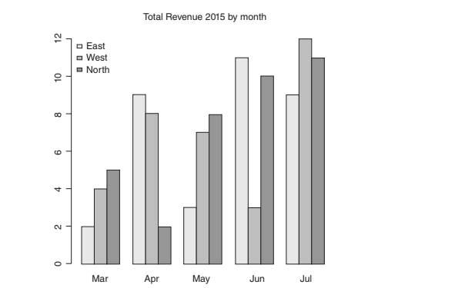
Group Bar Chart
A group data in R is used to handle multiple
inputs and takes the value of the matrix. This
group bar chart is created using the barplot()
function and accepts the matrix inputs.

Slide 138
Example 2
The bar chart is drawn horizontally by passing
the “horiz” parameter TRUE. This can be shown
with a sample program as follows:
# Create data for the bar chart
H <- c (8,13,30,5,28)
#Give a name for the bar chart
png(file = “samplebarchart.png”)
#Plot bar chart using barplot() function
barplot(H, horiz=TRUE))
#Save the file
dev.off()
> barplot(H, xlab = “Values”, ylab=“Categories”, col=“blue”,
horiz=TRUE)
Example
> colors <- c(“green”,“orange”,“brown”)
> months <- c(“Mar”,“Apr”,“May”,“Jun”,“Jul”)
> regions <- c(“East”,“West”,“North”)
> Values <- matrix(c(2,9,3,11,9,4,8,7,3,12,5,2,8,10,11),nrow=3,ncol
= 5,byrow = TRUE)
> Values
[,1] [,2] [,3] [,4] [,5]
[1,] 2 9 3 11 9
[2,] 4 8 7 3 12
[3,] 5 2 8 10 11
> rownames(Values) <- regions
> rownames(Values)
[1] “East” “West” “North”
> Values
[,1] [,2] [,3] [,4] [,5]
East 2 9 3 11 9
West 4 8 7 3 12
North 5 2 8 10 11
> colnames(Values) <- months
> Values
Mar Apr May Jun Jul
East 2 9 3 11 9
West 4 8 7 3 12
North 5 2 8 10 11
> barplot(Values, col=colors, width=2, beside=TRUE, names.
arg=months, main=“Total Revenue 2015 by month”)
> legend(“topleft”, regions, cex=0.6, bty= “n”, fill=colors);

Slide 139
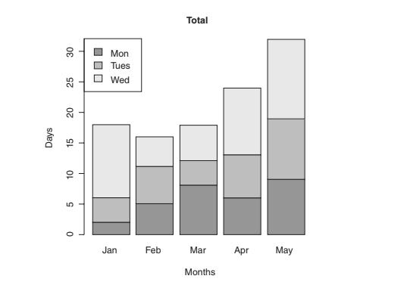
Stacked Bar Chart
Stacked bar chart is similar to group bar chart where multiple inputs can take different
graphical representations. Except by grouping the values, the stacked bar chart stacks
each bar one after the other based on the input values.
Example
> days <- c(“Mon”,“Tues”,“Wed”)
> months <- c(“Jan”,“Feb”,“Mar”,“Apr”,“May”)
> colours <- c(“red”,“blue”,“green”)
> val <- matrix(c(2,5,8,6,9,4,6,4,7,10,12,5,6,11,13), nrow =3, ncol
=5, byrow =TRUE)
> barplot(val,main=“Total”,names.arg=months,xlab=“Months”,ylab=“Day
s”,col=colours)
> legend(“topleft”, days, cex=1.3,fill=colours)

Slide 140
Key Terms
Bar chart: A bar chart is a pictorial representation of statistical data.
Data range: Data range is the difference between the largest and smallest data values in a dataset.
Data visualisation: The use of graphical representation to examine a given set of data is called data visualisation.
Density plot: A density plot is otherwise referred to as a ‘continuous histogram’ of a given variable, except the area of the curve under the density plot is equal to 1.
EDA: Exploratory Data Analysis (EDA) involves analysing datasets to summarise their main characteristics in the form of visual representations.
Frequency: Frequency is a summary of data occurrences in a collection of non- overlapping types.
Histogram: Histogram is a graphical illustration of the distribution of numerical data in successive numerical intervals of equal size.
Mean: Mean is generally referred to as summing up of input values and dividing the sum by the number of inputs.
Median: Median is the middle value of the given inputs.
Mode: Mode is similar to frequency except the value of mode returns the highest number of occurrences in a dataset.
Outliers: Outliers are considered to be incorrect or error input data.

